Slide 1

Agenda
○ | SDM Pharmacy Digital Landscape

Slide 2
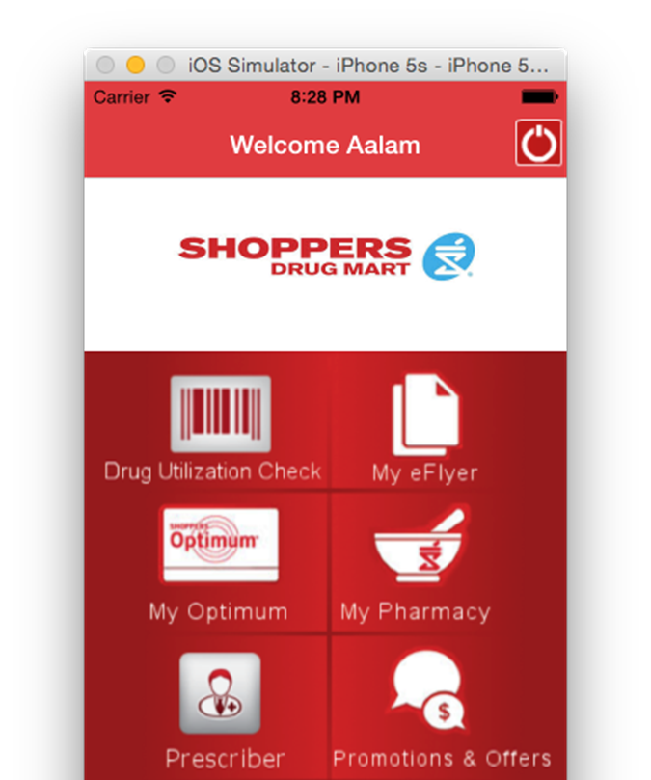
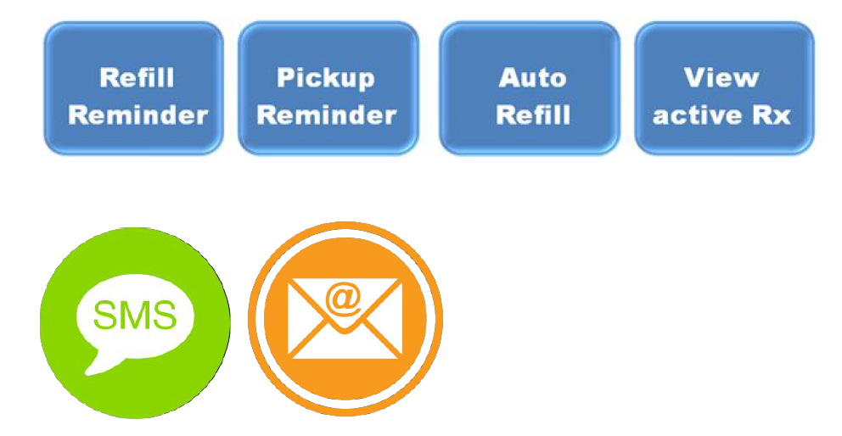
Shoppers Digital Landscape
Existing Mobile App Features
Access personalized offers
Load coupons directly to Shoppers optimum Card
Show digital Shoppers Optimum Card in-store
Earn and spend Shoppers Optimum Points
Check points balance and reward level
Check flyer deals
Order prescription refills
Schedule pharmacy refill reminders
Create your own shopping list
Find nearest store
LCL Digital Pharmacy Initiative Objectives
Phase 1 – Target 2016 Mid
Manage communication preferences
Signup to receive refill / pickup reminders and auto refill
Ability to view their active Rx’s
View/update profile
Access web services or interfaces on the smartphone within the mobile app
Later Phases – Target 2017-18
Integrate auto refill in to HW Delta
Pharmacy has visibility to patients who have signed up & update preferences, etc.
One patient view (i.e. each patient's individual store profile will remain as such)
Ability for customer to see Rx from more than one store in a single profile
Centralization of Rx data

